Slide 1

Lesson 4:
Build your first Android app

Slide 2
Views
Views are the user interface building blocks in Android
Bounded by a rectangular area on the screen
Responsible for drawing and event handling
Examples: TextView, ImageView, Button
Can be grouped to form more complex user interfaces
Notes:
Android comes with a large set of built-in classes for views (sometimes called widgets). For example, TextView, ImageView, and Button are commonly used views. Each View has different attributes depending on the type of View it is. Example attributes include width, height, whether it is visible, and more. For a TextView, example attributes include font size, font family, and the text to display.
Resources:
TextView
ImageView
Button

Slide 3
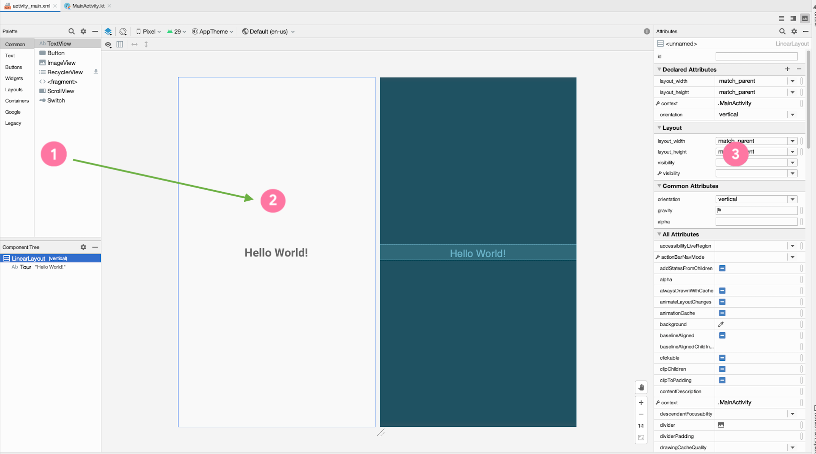
Layout Editor
Notes:
In Android Studio, build your layout with the Layout Editor.
Drag and drop components from the Palette (1) into the Design view (2).
See a preview of your layout in the Design view (2).
Modify the attributes of the views on the right hand side in the Attributes window (3).
Resource:
Build a UI with Layout Editor

Slide 4
XML Layouts
You can also edit your layout in XML.
Android uses XML to specify the layout of user interfaces (including View attributes)
Each View in XML corresponds to a class in Kotlin that controls how that View functions

Slide 5
XML for a TextView
<TextView
android:layout_width="wrap_content"
android:layout_height="wrap_content"
android:text="Hello World!"/>
Hello World!
Notes:
Here’s the XML for displaying a TextView in the layout. We see three attributes on the TextView: width, height, and text. These attributes are provided by either the base View class (width and height) or by the specific TextView class.

Slide 6
Size of a View
wrap_content
android:layout_width="wrap_content"
match_parent
android:layout_width="match_parent"
Fixed value (use dp units)
android:layout_width="48dp"
Notes:
Android has several ways to specify the width and height of a View. These examples are for the layout_width of a View, but the same applies for the layout_height attribute of a View.
Use wrap_content to use only as much space as needed to display the content within the View. For example, if you want the View to be as wide as the text within the TextView, use wrap_content.
Use match_parent to use the dimension of the parent (such as matching the width of the parent View). For example, if you want the ImageView to take up the full size of the parent, set match_parent for its width and height.
Lastly, if you want a fixed size for the View, then set a specific dp (density-independent pixels) value. We will be revisiting the concept of dps in the next lesson when we learn more about layouts.

Slide 7
ViewGroups
A ViewGroup is a container that determines how views are displayed.
LinearLayout
ConstraintLayout
TextView
TextView
TextView
TextView
Button
Button
The ViewGroup is the parent and the views inside it are its children.
Notes:
To show more than one view on screen, use a ViewGroup. A ViewGroup is a container for views, and controls how views are organized and laid out on screen. This slide shows examples of three different ViewGroups.
Use a FrameLayout if you have only one child View.
Use a LinearLayout to display views in a row or column.
Use a ConstraintLayout for more complex layouts.
In general, choose the ViewGroup that meets your needs without being overly complex. For example, if you can get the job done with a LinearLayout, then there is no need to use a ConstraintLayout.
Let’s look at the XML for some of these ViewGroups.

Slide 8
LinearLayout example
Aligns child views in a row or column
Set android:orientation to horizontal or vertical
<LinearLayout
android:layout_width="match_parent"
android:layout_height="match_parent"
android:orientation="vertical">
<TextView ... />
<TextView ... />
<Button ... />
</LinearLayout>
TextView
TextView
Button
Notes:
Here’s an XML example for the LinearLayout ViewGroup. LinearLayout is the parent for the three child views (two TextViews and a Button).
A LinearLayout lays out child views in a row or column. The layout direction is determined by the orientation attribute on the LinearLayout. In this case, the LinearLayout has a “vertical” orientation, so the layout will look like this diagram. Change the orientation to “horizontal” to have the views grouped in a horizontal row.

Slide 9
View hierarchy
ImageView
LinearLayout
TextView
ImageView
TextView
LinearLayout
Button
Button
Button
Button
Notes:
We’ve talked about how views can have parent - child relationships if they’re placed within a ViewGroup. ViewGroups can also contain other ViewGroups. This creates a hierarchy of views that represent the layout of what’s displayed on the screen (on the right).

Slide 10
App resources
Static content or additional files that your code uses
Layout files
Images
Audio files
User interface strings
App icon
Notes:
In addition to defining your own layouts, you can also add your own images, audio files, strings, app icon, and other resources to the app. Android provides a robust system to access them from anywhere in your app.

Slide 11
Common resource directories
Add resources to your app by including them in the appropriate resource directory under the parent res folder.
main
├── java
└── res
├── drawable
├── layout
├── mipmap
└── values
Notes:
The drawable directory stores all files related to drawing images and related assets.
The layout directory contains all the layout XML files for your application. There may be more than one if your app needs to handle different orientations or densities.
The mipmap directory contains files for your app icon (known as your launcher icon) at different screen densities.
The values directory contains files related to simple collections of strings, colors, integers, and styles. If you are localizing your app, you might have more than one values directory.
There are more subdirectories that may appear in the resources directory, but these are the ones that will be present in almost every Android project.

Slide 12
Resource IDs
Each resource has a resource ID to access it.
When naming resources, the convention is to use all lowercase with underscores (for example, activity_main.xml).
Android autogenerates a class file named R.java with references to all resources in the app.
Individual items are referenced with: R.<resource_type>.<resource_name>
Examples:
R.drawable.ic_launcher (res/drawable/ic_launcher.xml)
R.layout.activity_main (res/layout/activity_main.xml)

Slide 13
Resource IDs for views
Individual views can also have resource IDs.
Add the android:id attribute to the View in XML. Use @+id/name syntax.
<TextView
android:id="@+id/helloTextView"
android:layout_width="wrap_content"
android:layout_height="wrap_content"
android:text="Hello World!"/>
Within your app, you can now refer to this specific TextView using:
R.id.helloTextView
Notes:
If you assign IDs to the views in your layout, you can access them using R.id.<resource_name>. For example, this TextView has the resource ID name “helloTextView” and you can refer to it in your app using R.id.helloTextView. Be sure to use unique resource names so it is clear which element you want to refer to.

Slide 14
Activities

Slide 15
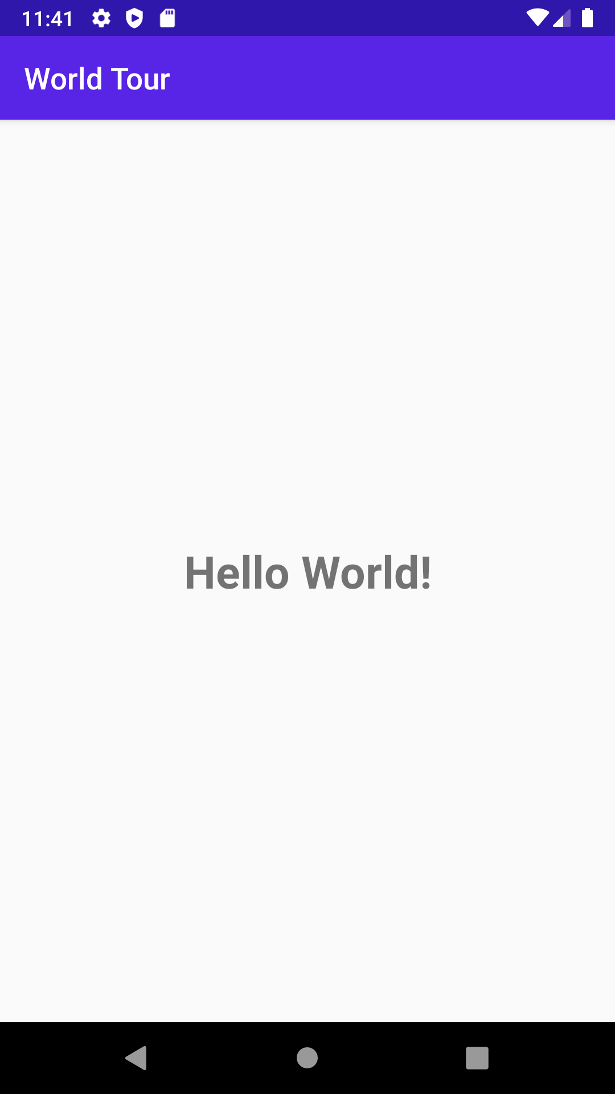
What’s an Activity?
An Activity is a means for the user to accomplish one main goal.
An Android app is composed of one or more activities.
Notes:
Examples of activities:
Displaying a list of emails
Displaying details of one specific item
Taking a photo using the camera

Slide 16
MainActivity.kt
class MainActivity : AppCompatActivity() {
override fun onCreate(savedInstanceState: Bundle?) {
super.onCreate(savedInstanceState)
setContentView(R.layout.activity_main)
}
}
Notes:
Let’s look at the code in MainActivity.kt. This was automatically generated because we selected the Empty Activity template in the new project wizard. Notice that it says “class” MainActivity.
It extends from the AppCompatActivity class, where we inherit behavior from the Android framework about how an Activity works. AppCompat for app compatibility ensures that newer features are available to legacy versions of Android.
Within the class, we have one function that is overriding the onCreate function that was defined in the superclass.

Slide 17
How an Activity runs
Activity launched
onCreate()
App is running
Activity shut down
Notes:
Instead of launching a program through the main() function, as shown in earlier lessons, Android starts your app through an Activity instance.
Once the user taps your app icon on the device, Android opens your app by launching the main Activity of your app. Specifically, the onCreate() method is called when your Activity is created. The onCreate() method is just one of the Activity callback methods that is invoked from the system at certain stages of the Activity lifecycle. We’ll talk more about the lifecycle in a future lesson. For now, know that your Activity continues to run until the user or system takes action to shut it down.
Resource:
Introduction to Activities

Slide 18
Implement the onCreate() callback
Called when the system creates your Activity
override fun onCreate(savedInstanceState: Bundle?) {
super.onCreate(savedInstanceState)
setContentView(R.layout.activity_main)
}
Notes:
Here’s what the onCreate() method looks like in the MainActivity.kt file of our sample app. In this callback method, we call into the superclass onCreate() method to set up the Activity. The Android framework handles a lot of this complexity for us. Then we call setContentView() so that the layout defined in the activity_main.xml file is displayed in the Activity. Let’s look at what happens when we call setContentView with a layout resource ID.
Resource:
onCreate()

